Slide 1
CEF 440: INTERNET PROGRAMMING AND MOBILE PROGRAMMING
GROUP 1: COURSE TASK 1

Slide 2
OUTLINE
DEFINITION OF MAIN TERMS
REVIEW MAJOR TYPES OF MOBILE APPS AND THEIR DIFFERENCES
REVIEW OF MOBILE APP PROGRAMMING LANGUAGES
COMPARISON OF MOBILE APP FRAMEWORKS BASED ON SOME KEY CRITERIA
MOBILE APP ARHITECTURES AND DESIGN PATTERNS
REVIEW OF REQUIREMENT ENGINEERING FOR MOBILE APP DEVELOPMENT
HOW TO ESTIMATE MOBILE APP DEVELOPMENT COST

Slide 3
DEFINITION OF KEY TERMS

Slide 4
INTERNET PROGRAMMING: Internet programming involves creating software applications that are accessed through the internet. These applications typically run on web servers and are accessed by users through web browsers.
MOBILE PROGRAMMING: Mobile programming on the other hand involves creating software applications specifically designed to run on mobile devices such as; smartphones and tablets. Mobile programming often involves developing applications for popular mobile operating systems like iOS (for Apple devices) and Android (for devices from various manufacturers).

Slide 5
Comparison of MAJOR TYPES OF MOBILE APPS AND THEIR DIFFERENCES

Slide 6
Feature | Native apps | Progressive web apps | Hybrids mobile apps
Development technology type | Platform specific | Responsive Web technologies | Combination of native plus web technologies
Access to device features | Full access (e.g camera, accelerometer etc ) | Limited access compared to native apps | Depends on frameworks used and the integrated plugins
Performance | Generally faster and smother | Usually slower compared to native apps | Depends on implementation but can be slower than navtive apps
Installation | Needs to be installed onto the device | Is accessed through the browser. Not installed | Needs to be installed
Development Cost | Higher cost due to separate development platform | Generally lower due to single code base | Usually lower that native but higher than PWAs
App updates | Pushed through app stores need to be downloaded | Updated in real time. No need to be downloaded | Can be done through apps stores or via the web
Examples | Instagram, Spotify (android and IOS versions) | Twitter lite, Pinterest | Evernote

Slide 7
Review of mobile app programming languages

Slide 8
1) Java
Native Android Programming Language
Multipurpose Object oriented for both Desktop and Mobile development
Disadvantages
No manual garbage collection
Comparatively slower than native C and C++
Code is usually more lengthy hence less readable
Advantages
Relatively simple to learn
Has a collection of open source libraries
that help mitigate cost and time
Support many programming tools (JUnit , ApacheANT, JRat)
Very secure compared to other languages

Slide 9
1I) KOTLIN
Native Androd Programming Language
Tailored specifically for mobile development
Disadvantages
Has fewer available resources since it is new as an android development language
Some android studio features like autocomplete are slower for kotlin that for java
Has a lower official support compared to java
Advantages
Develops apps in less time and is easier to deploy
It is interoperable and can easily be adopted for mobile dev
Lesser changes of bugs since its compiler detects almost if not all errors

Slide 10
1II) swift
Native IOS Programming Language
For development across various OS like IOS, macOS, watchOS etc
Advantages
Easy and concise
Takes less time compare to Objective-C to perform same task
Is 2.6x faster to develop IOS apps with compared to objective-C
Effective automatic memory management
Disadvantages
Code compatibility issues face with new language updates
Only useful for apps compatible with IOS7
or higher

Slide 11
1V) OBJECTIVE-C
Native IOS Programming Language
Object oriented , inherits from C language
Advantages
Is a mature language, Programmers easily find solutions to deadends while coding
Language is stable and new releases hardly need revisions making development and maintainance cheaper
support older versions of AppleOs
Disadvantages
Harder learning curve compared to other languages
Less secured apps compared to swift
The need to maintain 2 separate files increases development time and synchronizing effort

Slide 12
V) Javascript
Hybrid and PWA Programming Language
Versatile, high level, commonly used for web, interpreted, dynamic runtime behavior
Disadvantages
Perfomance overhead compared to native apps due to reliance on web views
Limited access to native or device features
Advantages
Cross-platform compatibility:
Javascript mobile apps can run on both Android and IOS with minimal modifications ( Hybrid apps )
Its dynamic nature and extensive ecosystem accelerates development, prototyping and iteration

Slide 13
Vi) dart
Hybrid Programming Language
Modern, object-oriented, for web server and mobile dev
Advantages
Dart (with flutter) offers hot reload for instant emulation
Use ahead-of-time (AOT) and just-in-time (JIT) compilations to provide performance on par with native apps
Clean and expressive syntax
Disadvantages
Developers new to reactive frameworks might encounter a learning curve
Less mature ecosystem with fewer libraries compared to javascript
Might encounter limitations in terms of platform specific features

Slide 14
Vii) C #
Hybrid Programming Language
Versatile, robust , developed by Microsoft
Disadvantages
Developers new to Xamarin might encounter a learning curve
encounter limitations in terms of platform specific features
Advantages
Used to develop cross-platform apps
Integration with Xamarin gives access to native APIs hence creating native-like applications
Rich and vibrant ecosystem, community, tools , libraries and resources
Xamarin also used AOT and JIT compilation providing better perfomance

Slide 15
REVIEW AND COMPARISON OF MOBILE APP DEVELOPMENT FRAMEWORKS

Slide 16
1) React native
Language : JavaScript
Perfomance : Generally good. Renders components to the native platform
Cost and Time to Market: Relatively reduced. Allows code reuse across different platforms
UI/UX: Component based architecture Allows for native-like experience, clean interfaces and smooth experience for users
Complexity : Moderate complexity with solid level of JavaScript needed
Community support: Very active and vibrant community, large number of libraries, plugins and assistant tools
When to use : Ideal for cross-platform development requiring frequent updates and quick prototyping

Slide 17
11) Flutter
Language : Dart
Perfomance : Excels in performance since it eliminates need for a javascript bridge
Cost and Time to Market: Cross-platform framework hence decreased cost and development time
UI/UX: Widget based architecture allows for highly customizable, consistent and beautiful UI
Complexity : Moderate complexity with solid level of Dart language needed
Community support: Rapidly growing with providing developers with resources to ease work
When to use : Ideal for Cross-platform apps with high UI requirements. Mostly used in gaming apps, media or streaming platforms

Slide 18
11I) IONic
Language : Web Technologies (HTML, CSS, JavaScript, typescript )
Perfomance : Might encounter issues due to it’s reliance on web technologies
Cost and Time to Market: Relatively quick and cost effective due to familiar web technologies
UI/UX: Extensive libraries and components provide relatively beautiful UI with native like feel
Complexity : Low to Moderate. Developers with web experience easily pick it up
Community support: ;Strong community support, large number of themes and plugins available
When to use : Ideal for Cross-platform apps with focus on content-based applications with rapid development cycles such as e-commerce and educational applications

Slide 19
1V) native script
Language : JavaScript and Typscript
Perfomance : Generally good. Has direct access to native APIs without need for a bridge
Cost and Time to Market: Cost effective and quick especially for teams with web experience
UI/UX: Its Native components provide a seemless native-like feel and interface for users
Complexity : Moderate complexity. Knowledge of javascript and typescript needed
Community support: ;Strong community support, large number of themes and plugins available
When to use : For Applications requiring close to native perfomances and access to Native APIs and tools

Slide 20
V) Xamarin
Language : C#
Perfomance : Fast execution and memory management leads to good performance
Cost and Time to Market: Development time might increase due to Issues with licensing fees and might decrease due to It’s ability to share code between forms
UI/UX: Very friendy user interfaces. Allows access to native customizable components
Complexity : Moderate to hight complexity with hight proficiency in C# needed
Community support: ;Strong community support, large number of themes and plugins available
When to use : Suitable for enteriprises invested in the Microsoft ecosystem and requiring hight performance cross-platform

Slide 21
MOBILE APPLICATIONS ARCHITECTURES and design patterns

Slide 22
1) Mobile app architectures
DEFINITION

Slide 23
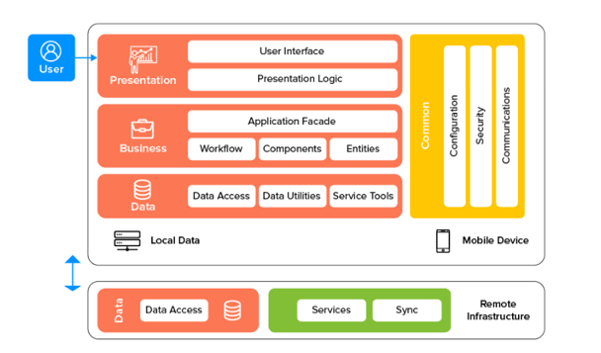
i) LAYERED ARCHITECTURE (3 LAYERED ARCHITECTURE )
Also known as N-tier architecture (divides the application into multiple layers)
Each layer is responsible for implementing a particular functionality
Key components (layers)
User Interface layer
Application layer
Data layer
Importance (Advantages
Scalability
Maintainability
Performance
Security

Slide 24
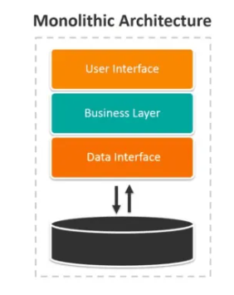
ii) Monolithic architecture
all components and modules of an application are tightly integrated into a single, unified unit
UI, application logic and data storage all bundled up in single code based and runs within a single process
Key Features
Single code base
Tight coupling
Single deployment unit
Shared Data Storage
Importance (Advantages
Easy to develop, test and initially deploy
Existence of a wealth of tools and knowledge for this type of development
Does not require communication between separate services

Slide 25
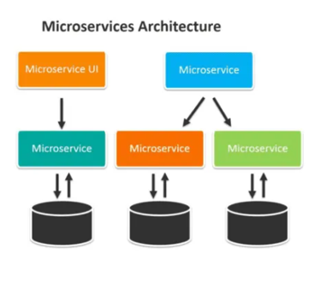
iIi) Microservices architecture
uses small, independent, and loosely coupled services operating simultaneously to provide its functionality
application is split into individual services, each responsible for a specific set of tasks or functionalities.
Key Features
Service independence
Loose coupling
Small and focused
Distributed deployment
Polyglot technology
Independent Data management
Importance (Advantages
Microservices can be individually scaled up or down as needed
Flexibility in choosing the most appropriate technology for each service
Smaller teams can work on individual services, hence faster development cycles
Failure in one service is less likely to impact the entire application

Slide 26
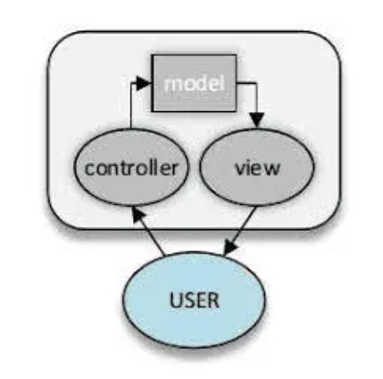
iv) Model-view-controller (mvc)
divides the application into three interconnected components
primary purpose of the MVC pattern is to separate the concerns of an application
Key Features
Model
View
Controller

Slide 27
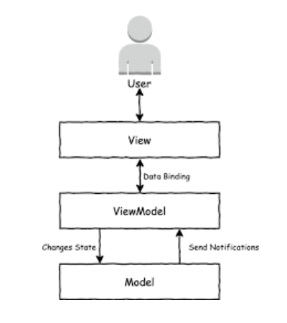
v) Model-view-viewmodel (mvvm)
An evolution of MVC mainly used for UI design in mobile and web apps
Also design to reflect separation of concerns of an application
Key Features
Model
View
ViewModel

Slide 28
vi) Model-view-presenter (mvp)
An evolution of the MVC Model
Key Features
Model
View
Presenter
vii) View interactor presenter entity routing (viper)
vii) Clean architecture

Slide 29
2) Mobile app design patterns
DEFINITION

Slide 30
1) SINGLETON PATTERN
Ensures that a class has only one instance.
Providing a global point of access to that instance.
Guarantees that all code refers to the same instance.
Useful when you want to limit resource usage, maintain consistency, or provide a shared service throughout the application.
Can be applied to scenarios like logging services, database connections, or configuration managers.

Slide 31
1I) OBSERVER PATTERN
Establishing a one-to-many dependency between objects.
Notifying dependents when the state of an object changes.
Ensures automatic updates and synchronization between objects.
Useful in scenarios such as real-time stock market updates, event-driven systems, or UI components that need to respond to changes in data.

Slide 32
II1) FACTORY PATTERN
Creating different instances of related objects based on conditions or parameters.
Allows subclasses to decide which class to instantiate.
Useful when you want to abstract the object creation process and decouple it from the client code.
Can be used in scenarios such as creating different character classes in a game or generating different types of documents based on user input.

Slide 33
1V) DEPENDENCY INJECTION
KEY ROLES
Client: The component or class that depends on services provided by another class.
Service: The component or class providing specific functionality.
Injector: Creates instances of services and injects them into the client.
Interface: Defines the contract that services must implement.
WHEN TO USE
Loose coupling and reusability.
Testability (inject mock or test doubles).
Maintainability and flexibility.
E.g in java frameworks like Spring or JavaScript frameworks like Nest, In Android development, frameworks like Dagger use DI to inject dependencies into activities, fragments, and services.
Decoupling components.
Enhancing testability.

Slide 34
V) ADAPTER PATTERN
KEY ROLES
Target Interface: Defines the interface expected by the client.
Adaptee: The existing class with an incompatible interface.
Adapter: Implements the target interface and internally uses an instance of the adaptee.
Client: Interacts with objects via the target interface.
WHEN TO USE
Adapting data from a REST API (with a specific format) to display in a RecyclerView.
Converting data from a database query to match the expected format in a ListView.
V1) DECORATOR PATTERN

Slide 35
REQUIREMENTS ENGINEERING
DEFINITION

Slide 36
tasks that help in understanding, recording, and managing the demands of stakeholders.
FEASIBILITY STUDIES
Technical feasibility
Operational feasibility
Economic feasibility
Legal and Regulatory feasibility
Schedule feasibility
REQUIREMENTS ELICITATION
DOCUMENTATION

Slide 37
REQUIREMENTS SPECIFICATION
Functional Requirements
Non-functional Requirements
Constraints
Acceptance criteria
REQUIREMENTS VERIFICATION AND VALIDATION
Verification
Validation
REQUIREMENTS MANAGEMENT

Slide 38
ADVANTAGES OF REQUIREMENTS ENGINEERING
Helps ensure that the software meets the needs and expectations of the stakeholders
Can help identify potential issues or problems early in the development process, allowing for adjustments to be made before significant errors at successive stages
Helps ensure that the software is developed in a cost-effective and efficient manner
Provides a solid foundation for the development process, which helps to reduce risk of failure

Slide 39
DISADVANTAGES OF REQUIREMENT ENGINEERING
Can be time-consuming and costly, particularly if the requirements gathering process is not well-managed
Changes in requirements can lead to delays and increased costs in the development process.

Slide 40
STUDY OF ESTIMATING MOBILE APP DEVELOPMENT COST

Slide 41
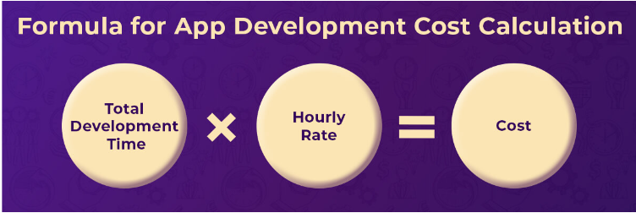
1) FORMULAR FOR CALCULATING COST

Slide 42
II) FACTORS INFLUECNING MOBILE APP DEVELOPMENT
CHOOSING YOUR TECHNOLOGY PARTNER
LOCATION OF THE APP DEVELOPMENT COMPANY
HIRING MODELS FOR THE APP DEVELOPMENT COMPANY
Time and material
Fixed cost
Hourly Rate

Slide 43
SCOPE AND TECHNOLOGY OF YOUR APPLICATION
APP DEVELOPMENT COST BASED ON TYPE OF APP
OnDemand Apps
E-commerce app
data driven Apps
Authentication app
Social media apps
APP DEVELOPMENT PLATFORM TO CATER
Android
iOS
Cross-platform
FUTURES, FUNCTIONALITIES AND COMPLEXITY
Simple Apps : todo, weather tracking
Mid-level Apps : Shopify, Mc Donalds
Complex Apps : Uber, snapchats etc

Slide 44
III) Mobile App Development Process with Cost Breakdown
DISCOVERY PHASE
DESIGN PHASE
DEVELOPMENT PHASE
TESTING AND DEPLOYMENT PHASE
MAINTENANCE AND SUPPORT PHASE

Slide 45
iv) WHOM AND WHEN SHOULD YOU HIRE FOR YOUR MOBILE APP DEVELOPMENT PROJECT
IN-HOUSE-APP DEVELOPMENT TEAM
FREE LANCE APP DEVELOPERS
OUTSOURCING MOBILE APP DEVELOPMENT COMPANIES

Slide 46
REFERENCES
https://en.m.wikipedia.org/wiki/Mobile_app# date: 29th march 2024
https://www.cs.ubbcluj.ro/~studia-i/journal/journal/article/view/43/43 date: 29th march 2024
https://www.mvps.net/docs/design-patterns-singleton-factory-observer/ date: 29th march 2024
https://medium.com/@stheodorejohn/exploring-javascript-design-patterns-c257aa261550 date: 29th march 2024
https://www.geeksforgeeks.org/dependency-injectiondi-design-pattern/ date: 29th march 2024
https://www.topdevelopers.co/blog/app-development-cost/#whom-should-you-hire-for-mobile-app-development-project-requirement date: 29th march 2024
https://www.octalsoftware.com/blog/mobile-app-architecture-guide date: 29th march 2024
https://www.spaceo.ca/blog/best-mobile-app-development-languages/ date: 29th march 2024
“Requirements Engineering in Software Engineering” geeksforgeeks, https://www.geeksforgeeks.org/software-engineering-requirements-engineering-process/ date 29th march 2024

Slide 47
END
NAME | MATRICULE
MEWOABI NGUEFACK DORE | FE21A239
ALEANU NTIMAEH ENOW | FE21A134
OJONG-ENYANG OYERE | FE21A297
FONGANG KELUAM PAUL DIEUDONNE | FE21A193
TANWIE BRUNO ADEY | FE21A316
TCHUIDJAN JORDAN BRYANT | FE21A320

